Slide 2
BINARY NUMBERS division
ICT 9 - Computer Systems Servicing

Slide 3


Slide 4
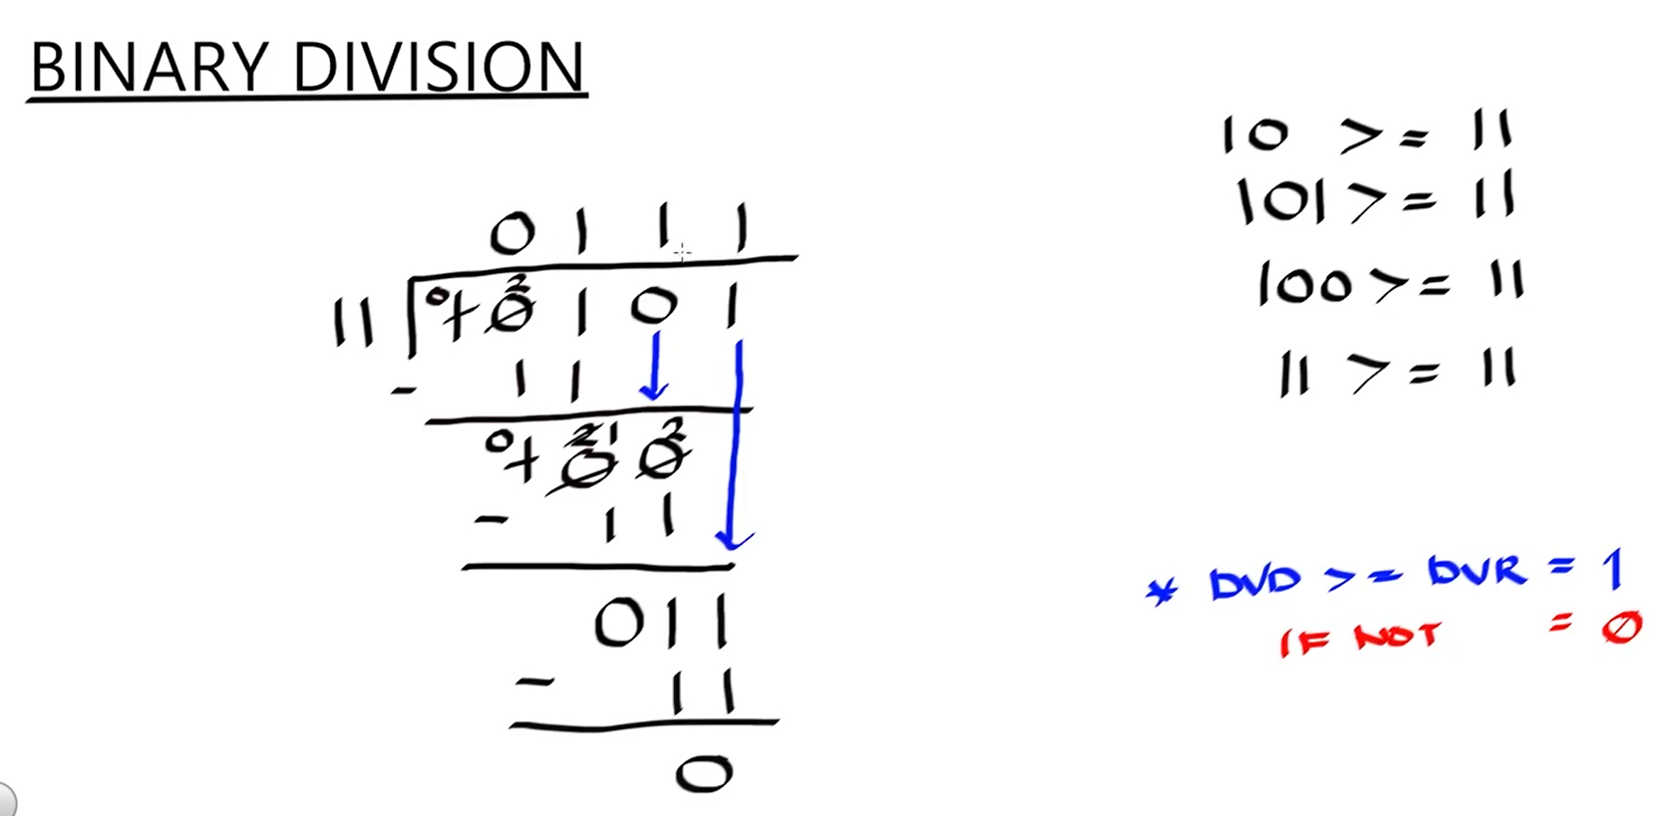

Slide 5
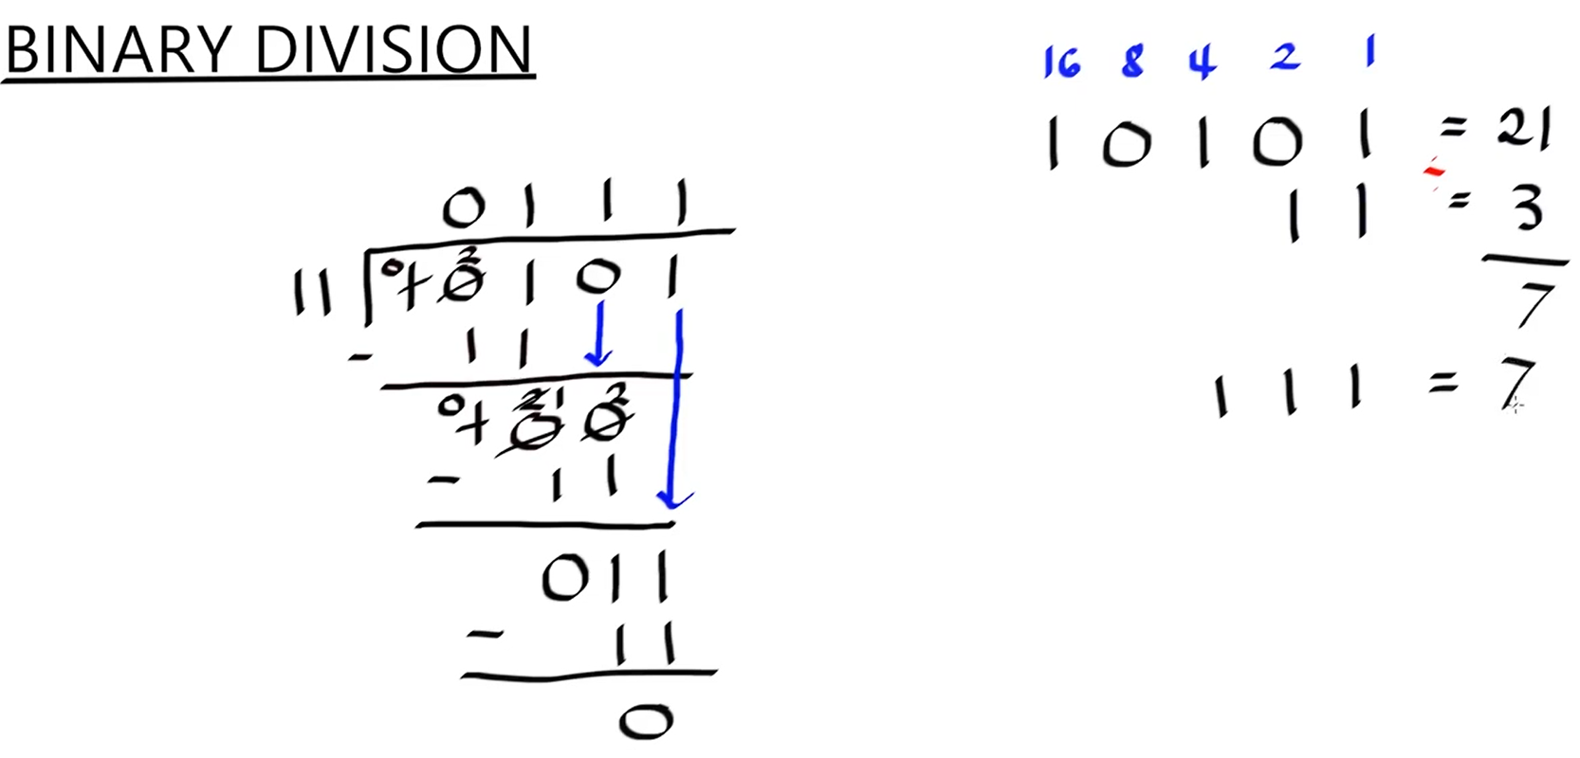

Slide 6
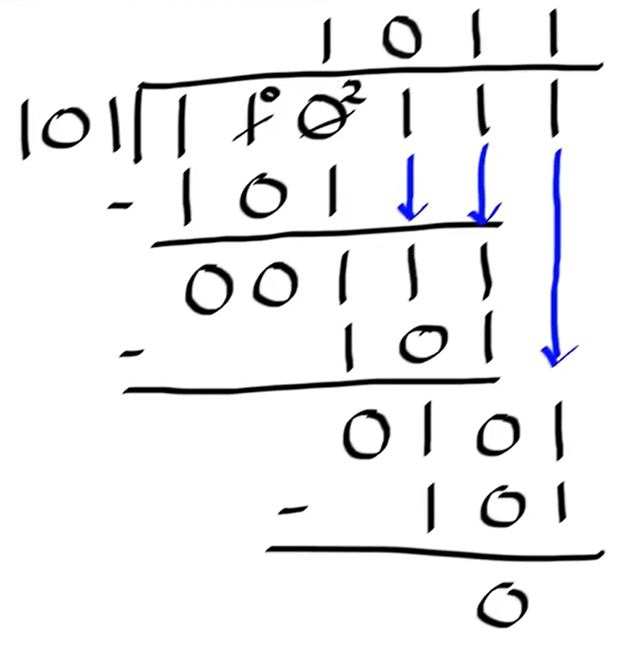
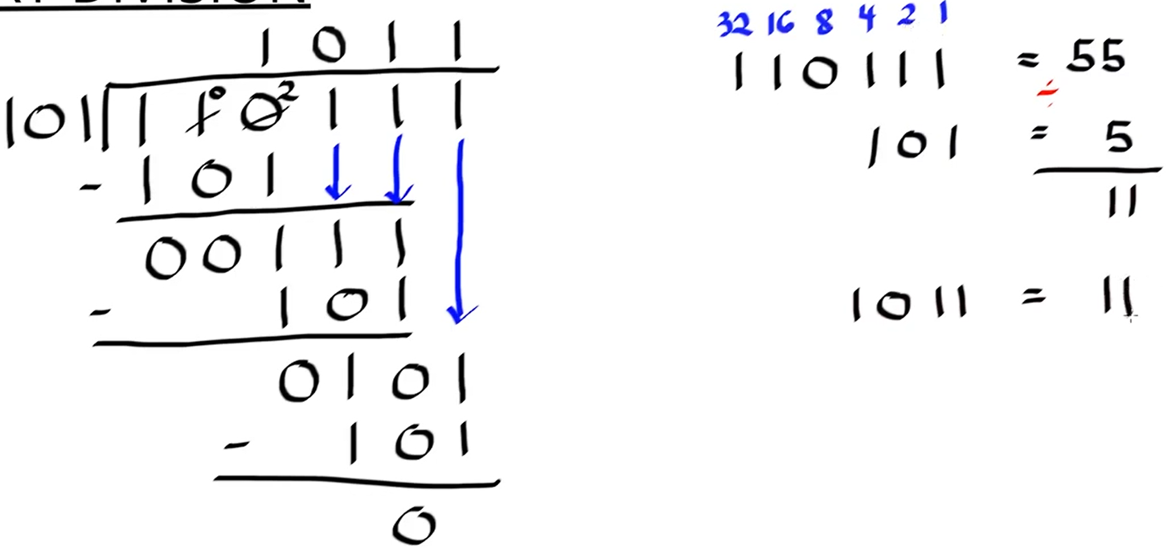

Slide 7
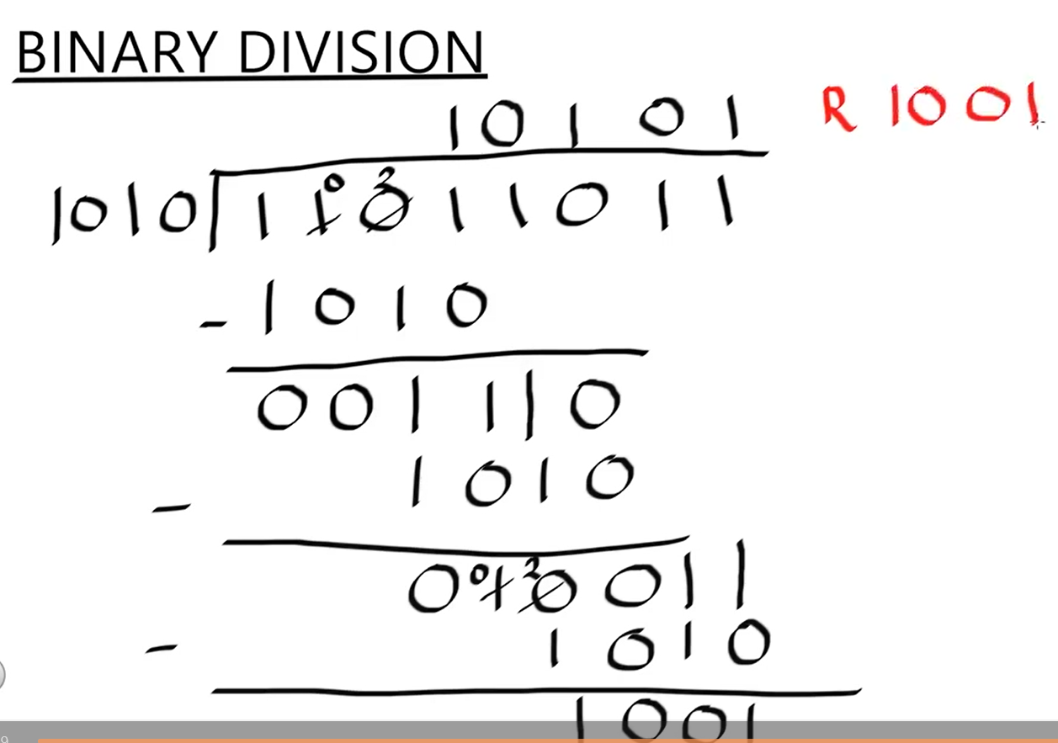

Slide 8
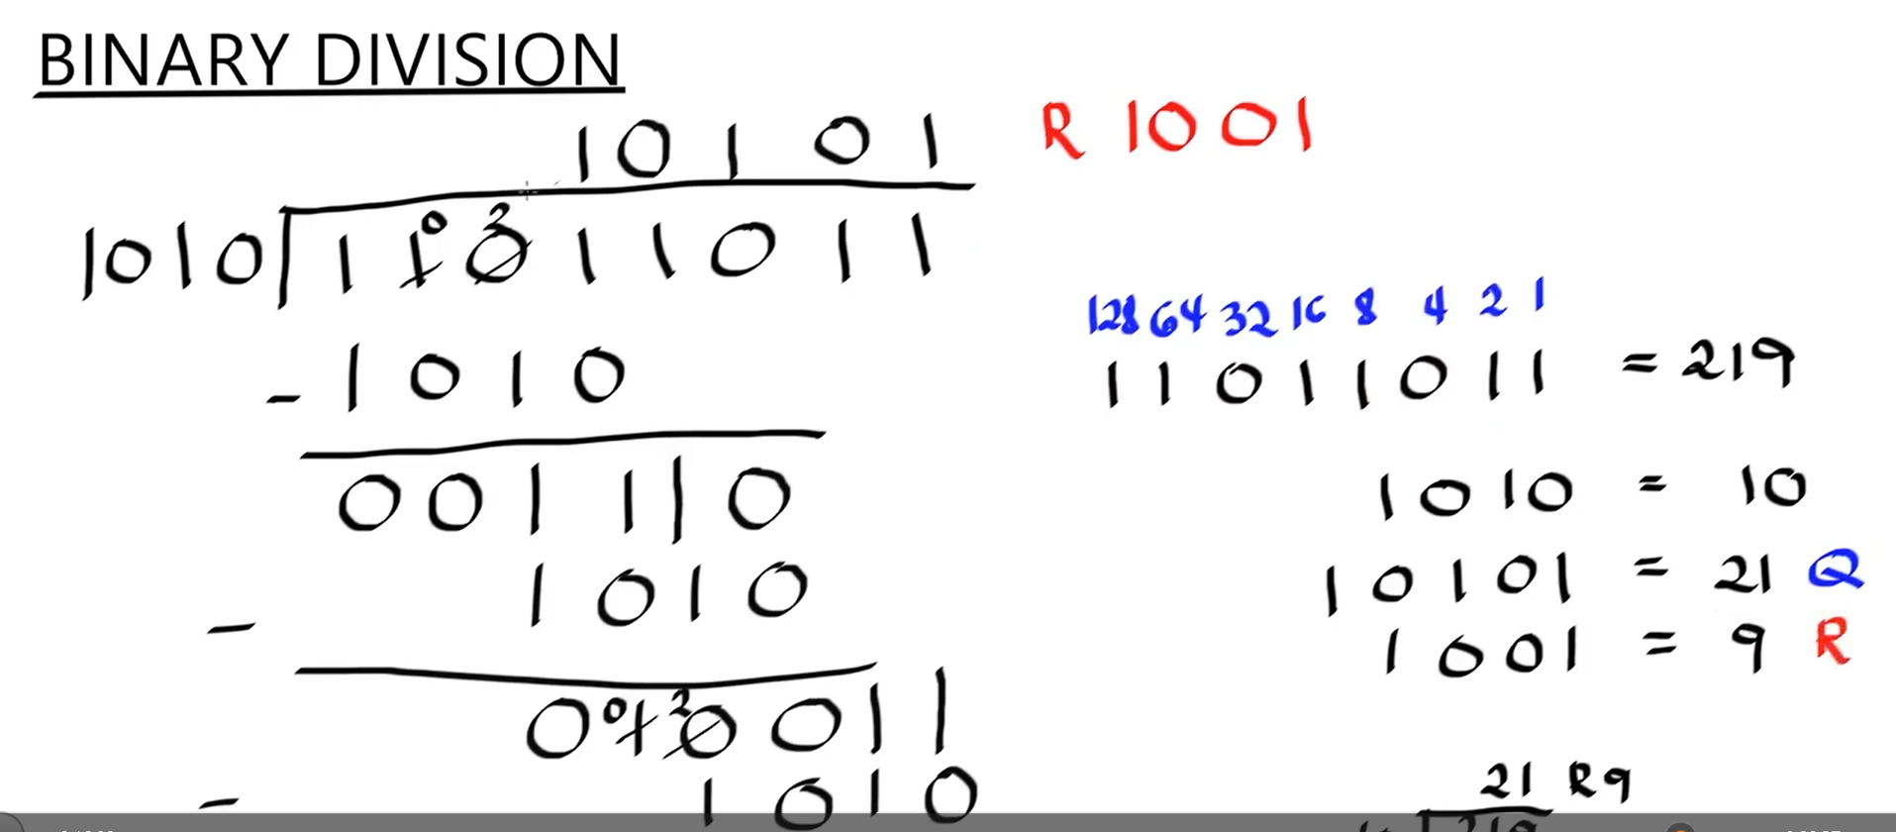

Slide 9
Divide the binary numbers-
111010 / 10=
2.110011 / 110=
3.100001 / 11=

Slide 10
Appetizer #12: Divide the binary numbers-
111010 / 111=
2.110011 / 110=
3.111001 / 10=
4.10011 / 11=
5.111000 / 110=

Slide 11
Thank You
for Learning
Teacher Mavic

